Slide 1
Real Time Object Detection through Webcam
Proposed by:
1. Muhammad Talha munir
2. Muhammad Yamin
3. Aqsa majeed

Slide 2
Agenda
Introduction
Problem statement
Dataset discussion
Methodology
Major Outcomes
Project Timeline
Conclusion

Slide 3
Introduction

Slide 4
Background
Computer Vision Introduction and History
Subfield of Artificial Intelligence
Uses Neural Networks for object detection from images and videos
Started back in 1950s but failed due to lack of data and processing power
First time used in the 1970s for the interpretation of hand-written text for visually impaired people
Improved with the help of large amount of data and processing power

Slide 5
Need
Used for object detection and object segmentation
Applications are in image processing for detecting the cancerous cells, classification of cars from CCTV videos, to live process football matches, in self-driving cars, in augmented and virtual reality.
In our project, to detect the object

Slide 6
Objectives
Implement an object detection machine learning model
First, classify the hand in front of webcam into empty or non-empty
if empty, voice message “hand is empty”
if non-empty, detect the object and give voice message with object name

Slide 7
Problem statement

Slide 8
Problem statement
Aim is to detect the real-time objects through a webcam
Will achieve using object detection and segmentation
Previously, no project providing output in voice command

Slide 9
Dataset discussion

Slide 10
Dataset Discussion
ImageNet dataset to train the object detection model
It was designed for computer vision research problems
It has 14 million images and 1000 classes
The labeling was done by public
It contribute in the field of computer vision by making many detection problem much easier.

Slide 11
Methodology

Slide 12
Methodology
The project has two main subtasks
Hand Detection
Object detection
Checking for empty hands
Voice command to tell user which object is in the hand
Technologies used:
OpenCV (cvzone,mediapipe) for Detection
Keras and tenflow (CNN model)
ImageNet dataset
GTTS (Google Text-to-Speech) for voice commands

Slide 13
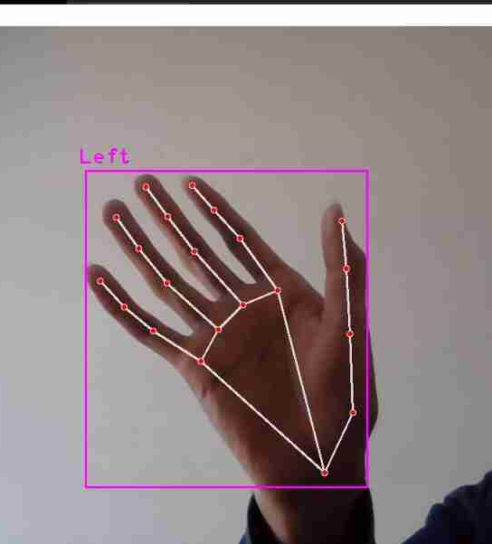
Methodology cont…
Hand detection Model
Basic computer vision task
Dozens of model and algorithm available that can detect hands and its positioning
OpenCV is a powerful python library
It provides CVzone package that contain built in tools for many detection problems
Hand Detection module of cvzone provide Bounding boxes , left or right label , centroid and many other information.

Slide 14
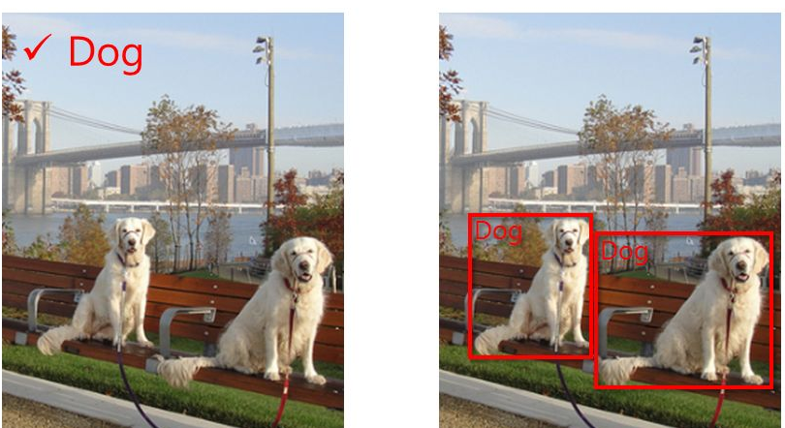
Methodology cont…
Object detection model
It is a combination of image
Classification and image localization
Deep learning model gain popularity Because of
the large data resources
Train a CNN model to detect the object
Using the bounding box of detected hand and
detected object to check whether the hand is empty or not

Slide 15
Major Outcomes

Slide 16
Major Outcomes
Frontend
An interactive dashboard
Inputs of the Model
Webcam
Video (MP4)
Backend
ML model will be deployed (ImageNet Dataset)
Output
Image segmentation
Image Detection
Model will respond in voice

Slide 17
Project Timeline

Slide 18
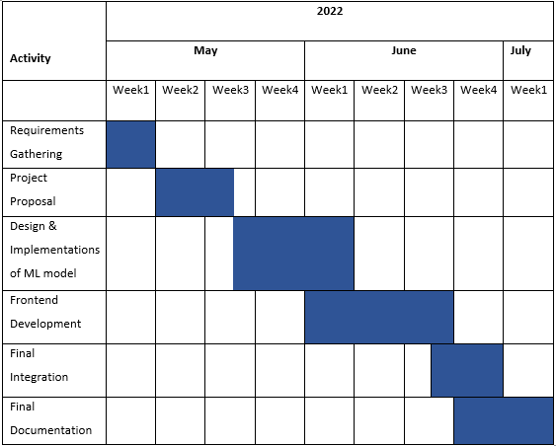
Timeline

Slide 19
Conclusion

Slide 20
Conclusion
Machine learning has reshaped the world
Transformed variety of industries, including healthcare, education, transportation, food, entertainment, and various manufacturing lines.
Object Detection become a major concern in many fields such as traffic surveillance, detection of stolen things, the medical field, etc.
ImageNet dataset will be used to train the model and deep learning and Open CV techniques will be used
The resultant system will have a momentous significance in the society.

Slide 21
Thank you

